Slide 1
Future driver data
Forecast
Historical data
Model
Hindcast of past conditions
Calibration of model

Slide 2
Legend:
Nitrogen
Phosphorus
Chlorophyll-a
Chlorophyll-a, nitrogen, and phosphorus
BVR inflow BVR dam weir FCR FCR dam FCR outflow
Figure 3. Conceptual diagram of hypothesized nitrogen, phosphorus, and chlorophyll-a concentrations along a double reservoir continuum

Slide 3
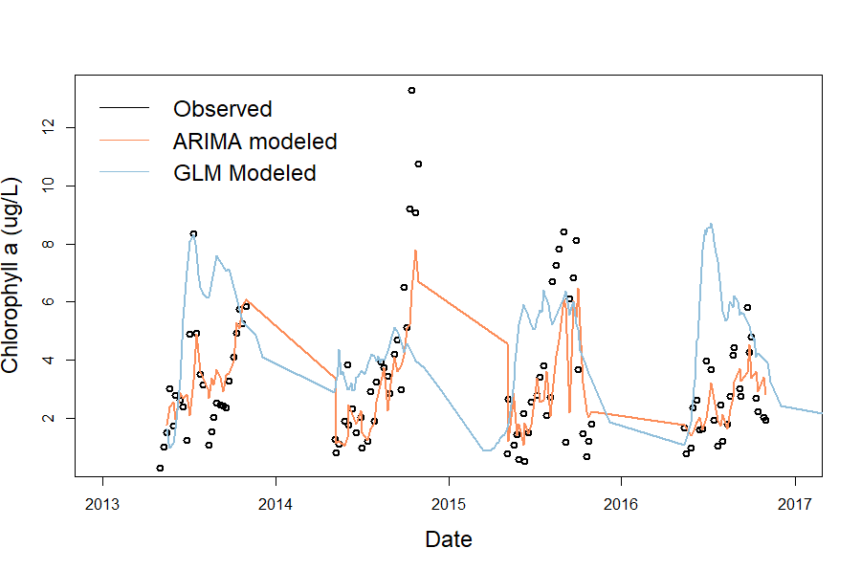

Slide 4
Legend:
NO₃
SRP & NH₄
Chlorophyll-a
Chlorophyll-a, nitrogen, and phosphorus
Riverine -> transitional -> lacustrine

Slide 5
Heterogeneity of chlorophyll-a
Hydrologic Flow

Slide 6
Nitrogen
Phosphorus
Chlorophyll-a
Legend:
NO₃
SRP & NH₄
Chlorophyll-a
BVR FCR
Riverine -> transitional -> lacustrine
Riverine -> transitional -> lacustrine
Figure 5. Hypothesized influence of reservoir chain number on relative concentrations of nitrogen, phosphorus, and chlorophyll-a. Reservoir chain number is R1 for Beaverdam Reservoir and R2 for Falling Creek Reservoir

Slide 7
Legend:
Beaverdam, R1
Falling Creek, R2
Nitrogen
Phosphorus
Chlorophyll-a
Riverine -> transitional -> lacustrine
Riverine -> transitional -> lacustrine
Riverine -> transitional -> lacustrine
Figure 5. Hypothesized influence of reservoir chain number on relative concentrations of nitrogen, phosphorus, and chlorophyll-a. Reservoir chain number is R1 for Beaverdam Reservoir and R2 for Falling Creek Reservoir

